Slide 1
Today’s Agenda
Upcoming Assignments
IDA Exam 1
Team Project Part 1
Last week’s Lab
Lecture
RCTs/Interventions
Cohort Studies
Calculating 95%Cis (StatCalc, Open Epi)

Slide 2
Upcoming assignment due dates
Friday February 1
Individual Data Analysis Part 1 Exam
Friday February 8
Team Project Part 1

Slide 3
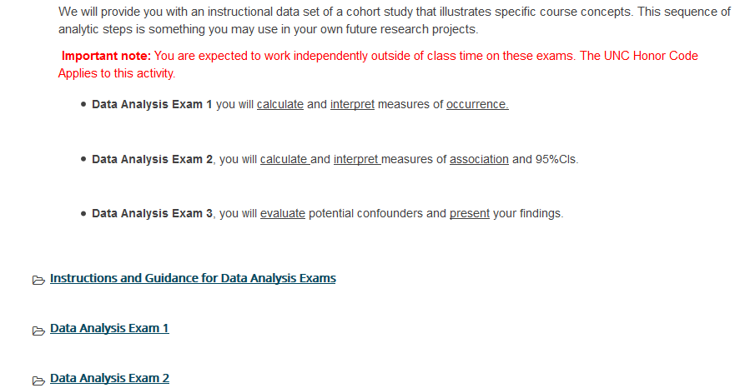
IDA1 Exam Tips
See Detailed IDA guidebook for step by step instructions

Slide 4
Rounding Rules
Round each number reported in tables to two digits after the decimal place. Round up for a number ≥5
Do not round in intermediate computation steps
Examples: 2.789 would be rounded to 2.79; 1.054 would be 1.05; 0.0852 would be 0.09

Slide 5


Slide 6
Team project topic Part 1
Put your topic in context
WHY IS IT of Public Health importance?
Example
Hypothesis: Those on financial add cook more at home.
How are you going to use your findings? Justify an educational intervention? Argue for more resources? Implications for healthy food availability near campus?

Slide 7
Comments on Team Project
Time Interval
Remember that you will be measuring prevalence of exposure and outcome for your team project.
Be specific about time interval-in the last year? in the last month? In the last week? You will be asking participants to remember.
Will their answers be an absolutely perfect measurement? No.
Will it allow you to categorize them relative to each other as “a little, middling, a lot”? Probably.

Slide 8
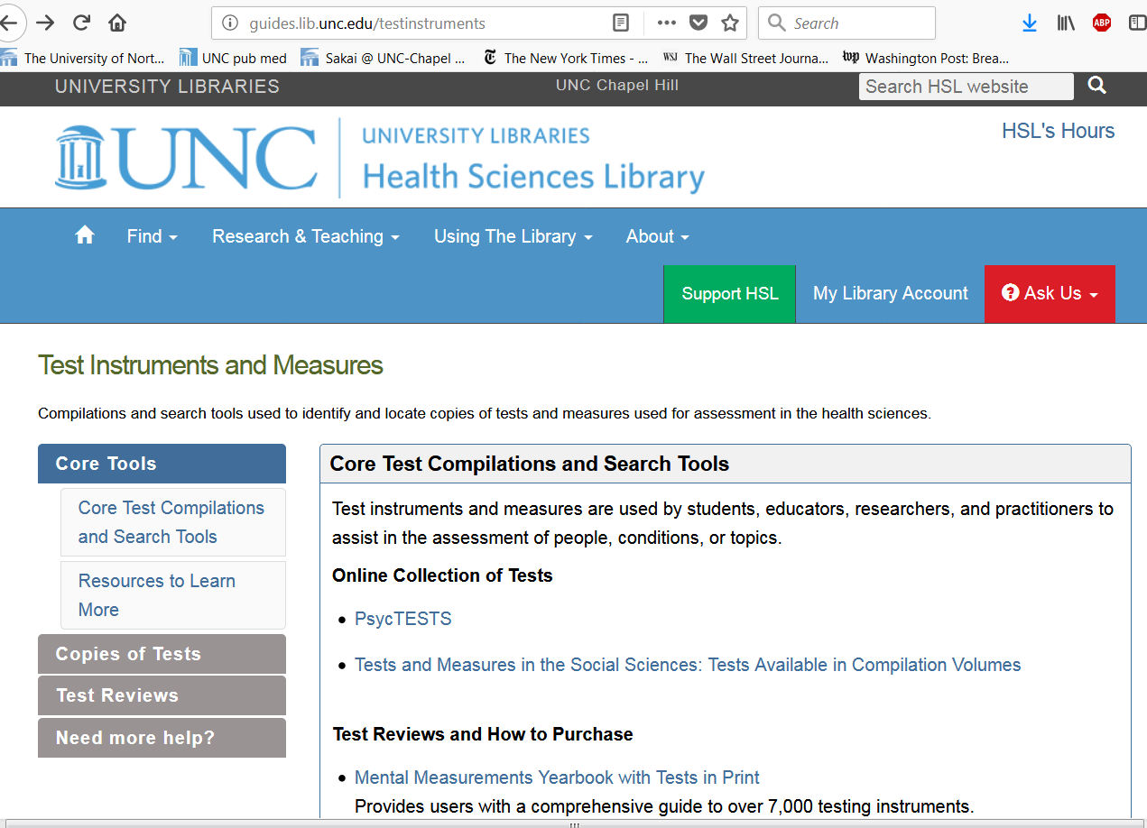
Team Project Topic Resource

Slide 9
Measures of association lab

Slide 10
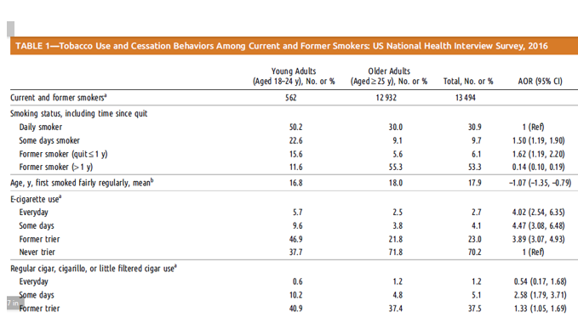
Table Orientation-Different than you’ve previously seen

Slide 11
Revised Table Orientation
 | Smoking Status |  | E-cig use |  | Regular Cigar use
 | Some Days smoker | Daily Smoker | Ecigs every day | E-cigs Never | Cigar Every day | Never trier
Young, 18-24 yrs | 22.6 | 50.2 | 5.7 | 37.7 | 0.6 | 1.2
Older, 25 yrs or more | 9.1 | 30.0 | 2.5 | 71.8 | 48.4 | 56.6

Slide 12
Calculating the odds ratio
E-cig every day
E-cig never
OR= (Oddsexp)/
(Oddsunexp)
Referent=E-cig never
18-24 yrs
a
b
25yrs or more
c
d
OR=(a*d)/(c*b)

Slide 13
Calculating the odds ratio
E-cig every day
E-cig never
18-24 yrs
_{5.7}
37.7
25yrs or more
2.5
71.8
OR=(5.7*71.8)/(2.5*37.7)=4.34 which approximates AOR of 4.02
AOR is from logistic regression adjusted for gender, race, education, religion, and subjective financial status

Slide 14
Odds Ratio Interpretation
The odds of daily E-cigarette use in those aged 18-24 was 4.02 times that of those aged 25 and older. 95%CI does not include the null value, therefore the result is statistically significant.

Slide 15
Prevalence, Risks, Rates
Applied to your team project
You will calculate prevalence measures for your team project
The questions on calculating risks and rates were hypothetical,
i.e. if you were going to calculate a risk, what would be in your numerator and denominator
Rationale-applying these concepts to a topic you selected

Slide 16
Study Designs: Cohort, RCTs, Interventions
EPID600
January 29, 2019

Slide 17
Course Objectives
Explain the importance of epidemiology for informing scientific, ethical, economic and political discussion of health issues.
Describe a public health problem in terms of person, place, and time.
Apply the basic terminology and definitions of epidemiology.
Calculate basic epidemiology measures.
Identify key sources of data for epidemiologic purposes.
Evaluate the strengths and limitations of epidemiologic reports.
Comprehend basic ethical and legal principles pertaining to the collection, maintenance, use and dissemination of epidemiologic data.
Draw appropriate inferences from epidemiologic data.
Identify the principles and limitations of public health screening programs.
Communicate epidemiologic information to lay and professional audiences.
Apply concepts, methods, and tools of public health data collection, analysis and interpretation, and the evidence-based reasoning and informatics approaches that are essential to public health practice.

Slide 18
Class Objectives
•Explain the definition of a cohort
•Recognize which measures of disease occurrence are used in a cohort
•Distinguish between prospective and retrospective cohorts
•List the advantages and disadvantages of cohorts

Slide 19
Class Objectives
•Differentiate observational studies from experimental studies
•Describe the purpose of randomization
•Define the terms masking/blinding and equipoise
•Identify the advantages and disadvantages of clinical trials

Slide 20
How do you identify the study design in a published study?
Ask these 2 questions:
When were exposure and outcome measured? (with respect to investigator)
Exposure before outcome?
Outcome before exposure?
Exposure and outcome at same time?
What was the unit of analysis?
Group or individual?

Slide 21
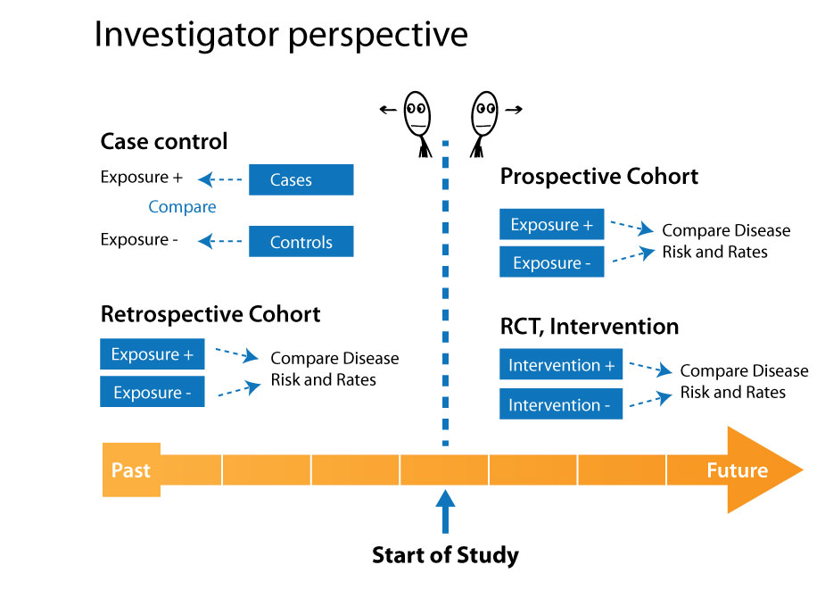

Slide 22
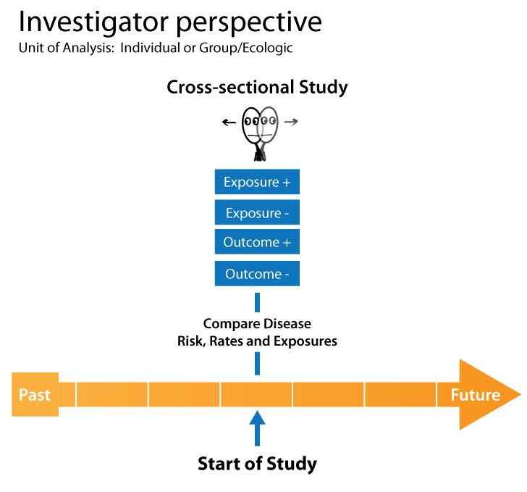

Slide 23
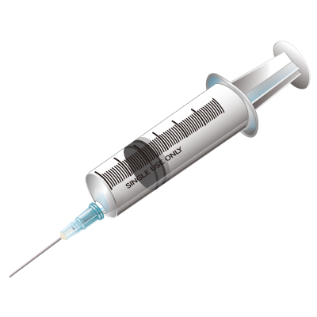



Experimental Studies
(investigator assigns exposure)

Slide 24
Experimental vs. Non-experimental Studies
Experimental:
Investigator randomly assigns exposure
Example: randomized control trials
Non-experimental:
Observational, does not assign exposure
Example: case-control, cohort, ecologic, cross-sectional

Slide 25
Randomized Controlled Trial
Treatment
Group
Comparison
Group
TIME
TIME
Health
Outcome
NO Health
Outcome
Health
Outcome
NO Health
Outcome

Slide 26
Randomized Control Trials
Test new drugs or medical treatments
Drug or treatment is randomized
Intervention group and control group should be comparable in all aspects
Strongest evidence for causal inference
Helps prevent bias

Slide 27
Caveat on term “control group”
In the context of randomized control trials, a “control group” means the unexposed group, or those that do not receive the exposure of interest.
When we cover case control studies, we will learn another use of the term “control group”

Slide 28
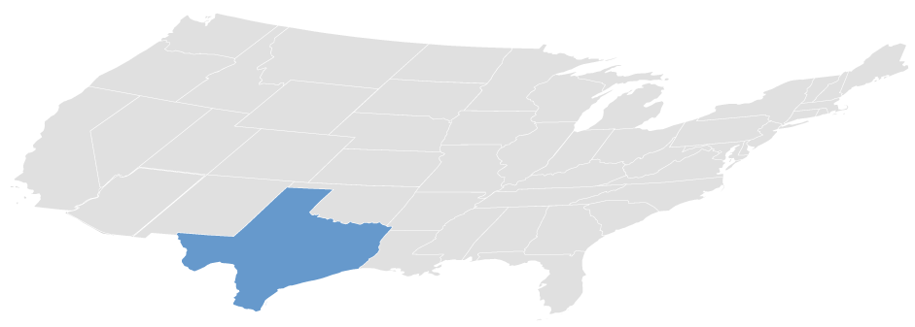
experimental
Individual
Community

Slide 29
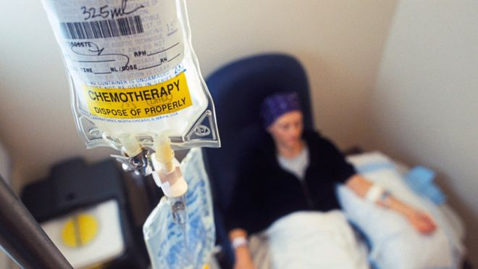
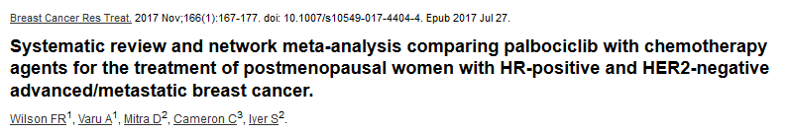
Experimental-Individual
Notes:
Breast Cancer Res Treat. 2017 Nov;166(1):167-177. doi: 10.1007/s10549-017-4404-4. Epub 2017 Jul 27.
Systematic review and network meta-analysis comparing palbociclib with chemotherapy agents for the treatment of postmenopausal women with HR-positive and HER2-negative advanced/metastatic breast cancer.
Wilson FR¹, Varu A¹, Mitra D², Cameron C³, Iyer S².
Author information
Abstract
PURPOSE:
To compare palbociclib + letrozole and palbociclib + fulvestrant with chemotherapy agents in postmenopausal women with hormone receptor-positive (HR+)/human epidermal growth factor receptor 2-negative (HER2-) advanced/metastatic breast cancer (ABC/MBC) who had no prior systemic treatment for advanced disease (first line) or whose disease progressed after prior endocrine therapy or chemotherapy (second line).
METHODS:
A systematic search identified randomized controlled trials (RCTs) published from January 2000 to January 2016 that compared endocrine-based therapies, chemotherapy agents, and/or chemotherapy agents + biological therapies in the first- and second-line treatment of postmenopausal women with HR+/HER2- ABC/MBC. The main outcome of interest was progression-free survival (PFS)/time to progression (TTP). Bayesian network meta-analyses (NMAs) and pairwise meta-analyses were conducted. Heterogeneity and inconsistency were assessed.
RESULTS:
Sixty RCTs met eligibility criteria and were stratified by line of therapy. In the first line, palbociclib + letrozole showed statistically significant improvements in PFS/TTP versus capecitabine [intermittent: HR 0.28 (95% CrI 0.11-0.72)] and mitoxantrone [HR 0.28 (0.13-0.61)], and trended toward improvements versus paclitaxel [HR 0.59 (0.19-1.96)], docetaxel [HR 0.51 (0.14-2.03)] and other monotherapy or combination agents (HRs ranging from 0.24 to 0.99). In the second line, palbociclib + fulvestrant showed statistically significant improvements in PFS/TTP versus capecitabine [intermittent: HR 0.28 (0.13-0.65)], mitoxantrone [HR 0.26 (0.12-0.53)], and pegylated liposomal doxorubicin [HR 0.19 (0.07-0.50)], and trended toward improvements versus paclitaxel [HR 0.48 (0.16-1.44)], docetaxel [HR 0.71 (0.24-2.13)] and other monotherapy or combination agents (HRs ranging from 0.23-0.89). NMA findings aligned with direct evidence and were robust to sensitivity analyses.
CONCLUSIONS:
Palbociclib + letrozole and palbociclib + fulvestrant demonstrate trends in incremental efficacy compared with chemotherapy agents for the first- and second-line treatment of HR +/HER2- ABC/MBC.

Slide 30
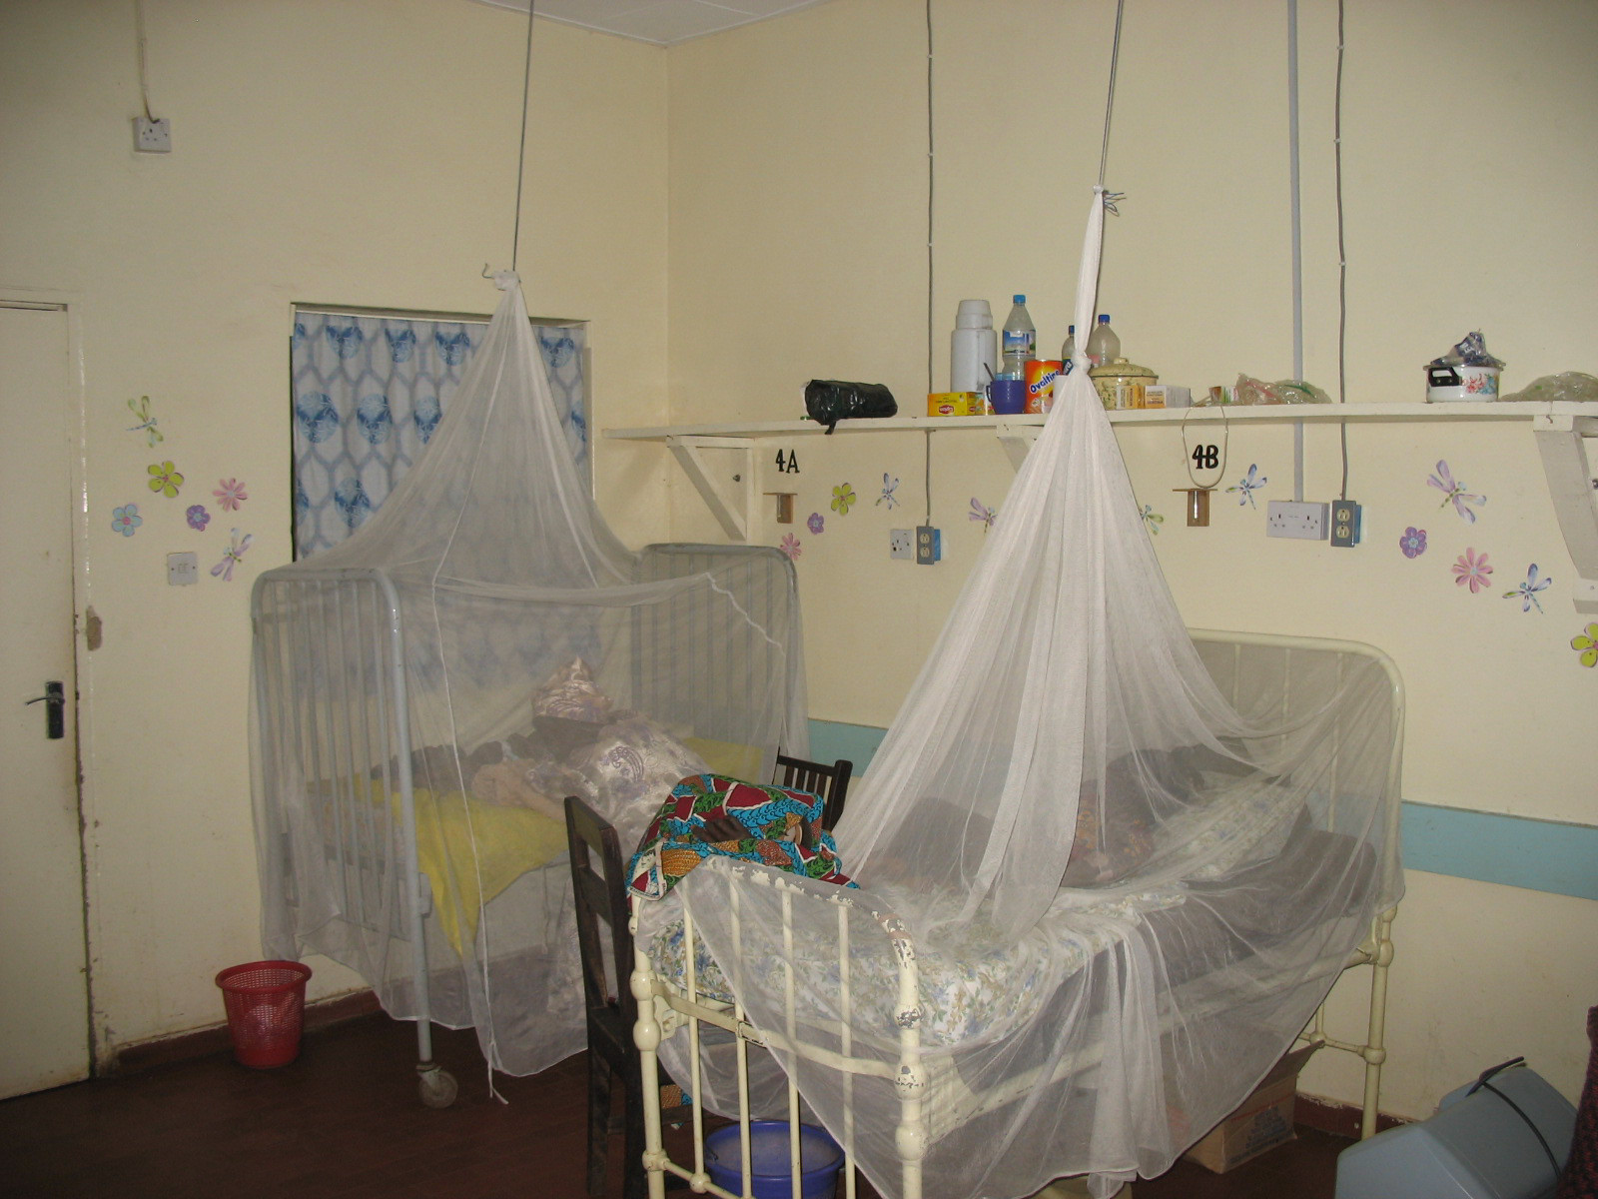
Do bednets in infants 6mo and younger
reduce malaria incidence and mortality?
Notes:
To test if bednets reduced infant contracting and dying from malaria, researchers randomized a group of infants to receive bed nets from birth onwards. The control group of infants received bednets after 6 months. Researchers found that the use of the bed nets in infants reduced the rate of both developing malaria and dying from malaria.

Slide 31
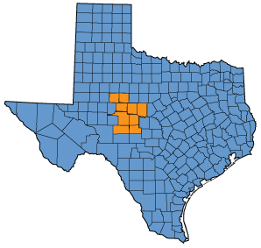
Experimental
Community

Slide 32

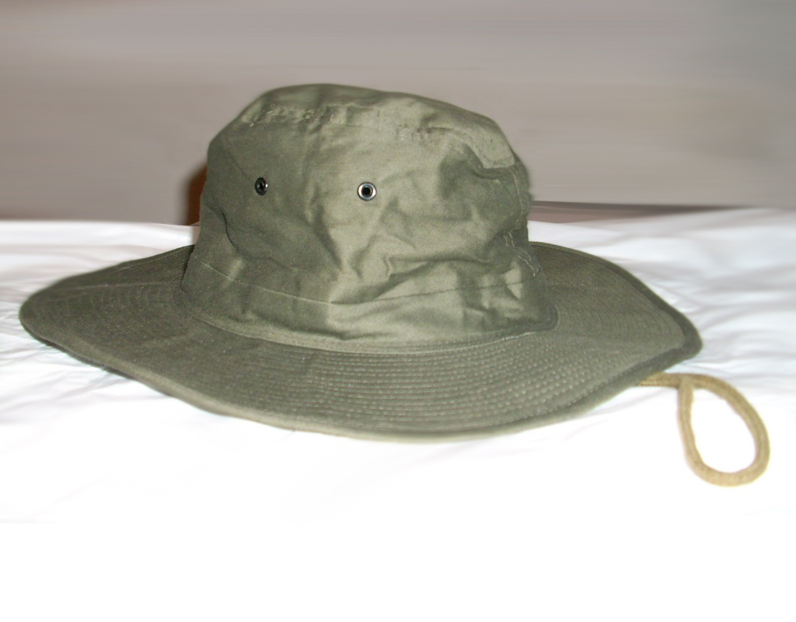
Example:
Randomized Control
Study Population:
U.S. Postal Workers
Intervention exposure (randomized): hats, sunscreen, reminders, educational sessions
Notes:
The intervention included 6 educational sessions, wide-brim hats, sunscreen, and reminders.
…
http://www.flickr.com/photos/24112094@N00/4952261563/
Photo Credit: <a href="http://www.flickr.com/photos/24112094@N00/4952261563/">superba_</a> via <a href="http://compfight.com">Compfight</a> <a href="http://creativecommons.org/licenses/by/2.0/">cc</a>

Slide 33
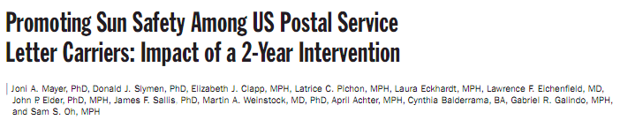
Example:
Randomized Control
Study Population:
U.S. Postal Workers
Randomization: At US Postal Service Level
Intervention exposure: hats, sunscreen, reminders, educational sessions
Notes:
The post men were then followed for 2 years to assess the outcome.

Slide 34

Example:
Randomized Control
Study Population:
U.S. Postal Workers
Intervention exposure (randomized): hats, sunscreen, reminders, educational sessions
Outcome: Increased sun safety (hat wearing & sunscreen use)
Notes:
The researchers found that the postmen receiving the intervention had increased use of sunscreen and hats compared with the control group.
…
http://www.flickr.com/photos/14580956@N08/2810172792/
Photo Credit: <a href="http://www.flickr.com/photos/14580956@N08/2810172792/">RobBixbyPhotography</a> via <a href="http://compfight.com">Compfight</a> <a href="http://creativecommons.org/licenses/by/2.0/">cc</a>

Slide 35
NIH definition and case studies of clinical trials
https://grants.nih.gov/policy/clinical-trials/case-studies.htm
Does the study involve human participants?
Are the participants prospectively assigned to an intervention?
Is the study designed to evaluate the effect of the intervention on the participants?
Is the effect being evaluated a health-related biomedical or behavioral outcome

Slide 36
Intervention
Treatment
Group
Comparison
Group
1. W or w/out
Randomization
2. W or w/out
comparison
group
3.Pre/Post compare
TIME
TIME
Health
Outcome
NO Health
Outcome
Health
Outcome
NO Health
Outcome

Slide 37
Examples
RCT:
Effectiveness of the Healthy Lifestyles Programme (HeLP) to prevent obesity in UK primary-school children: a cluster randomised controlled trial.
Lloyd J, Creanor S, Logan S, Green C, Dean SG, Hillsdon M, Abraham C, Tomlinson R, Pearson V, Taylor RS, Ryan E, Price L, Streeter A, Wyatt K.
Lancet Child Adolesc Health. 2018 Jan;2(1):35-45. doi: 10.1016/S2352-4642(17)30151-7.
Pre/Post Intervention:
Neonatal mortality and morbidity in the post-implementation period of a neonatal teaching program in provincial hospitals in Laos.
Schmidt S, Bounnack S, Hoehn T.
Public Health. 2018 Jan;154:123-129. doi: 10.1016/j.puhe.2017.10.021. Epub 2017 Dec 22.

Slide 38
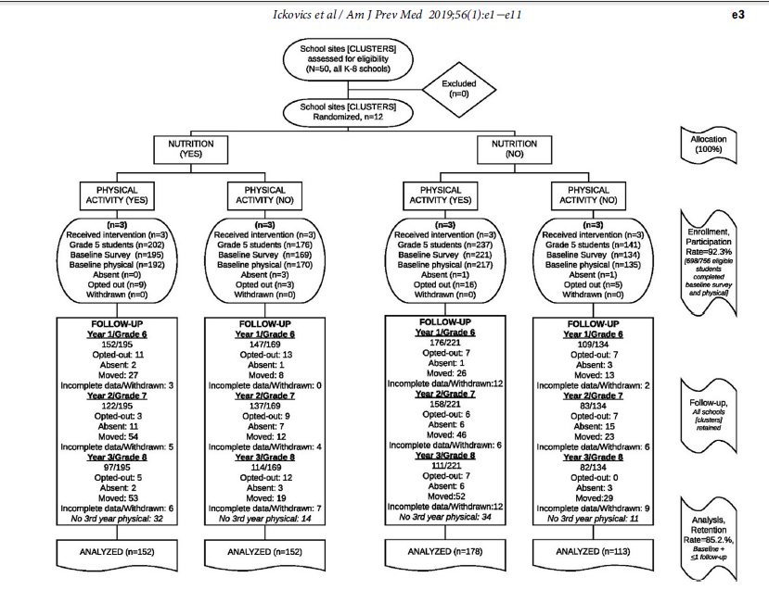
Implementing School-Based Policies to Prevent
Obesity: Cluster Randomized Trial
Notes:
Introduction: Healthier school environments can benefit students, and school wellness policies may
result in meaningful enhancements. Schools participating in federal child nutrition programs must
implement wellness policies as mandated by law. The primary study objective is to assess effectiveness
of implementing school-based nutrition and physical activity policies on student BMI trajectories.
Study design: Cluster randomized trial using 2 £ 2 factorial design.
Setting/participants: Twelve randomly selected schools in an urban district. Students were followed
for 3 years through middle school, fifth to eighth grades (2011−2015, n=595 students, 92.3%
participation, 85.2% retention).
Intervention: Specific to randomized condition, support was provided for implementation of
nutrition policies (e.g., alternatives to food-based rewards/celebrations) and physical activity policies
(e.g., opportunities for physical activity during/after school).
Main outcome measures: Sex-/age-adjusted BMI percentile and BMI z-score; behavioral indicators.
Data collected via standardized protocols.
Results: Analyses followed intention-to-treat principles, with planned secondary analyses (conducted
2016−2018). Students at schools randomized to receive support for nutrition policy implementation
had healthier BMI trajectories over time (F=3.20, p=0.02), with a greater magnitude over
time and cumulatively significant effects 3 years post-intervention (b= −2.40, p=0.04). Overall, students
at schools randomized to receive the nutrition intervention had an increase in BMI percentile
of <1%, compared with students in other conditions, whereas BMI percentile increased 3%−4%.
There was no difference in student BMI between those in schools with and without physical activity
policy implementation. Examining behavioral correlates in eighth grade, students at schools randomized
to the nutrition condition consumed fewer unhealthy foods and sugar-sweetened beverages,
and ate less frequently at fast-food restaurants (all p<0.03).
Conclusions: This cluster randomized trial demonstrated effectiveness of providing support for
implementation of school-based nutrition policies, but not physical activity policies, to limit BMI
increases among middle school students. Results can guide future school interventions.
Trial registration: This study is registered at www.clinicaltrials.gov NCT02043626.
Am J Prev Med 2019;56(1):e1−e11.

Slide 39

Blinding
Blinding in randomized trials: hiding who got what
Kenneth F Schulz, David A Grimes Lancet 2002; 359: 696–700

Slide 40
4 Types of Blinding
WHO IS BLIND
STUDY TYPE
SUBJECT
RESEARCHER
ANALYST
Non-blinded
Single-blinded
Double-blinded
Triple-blinded
OR
Notes:
Non-blinded: everyone knows who received which interventions
Single-blinded: one category of person is blinded
Double-blinded: both the tester and the subject are blinded
Triple-blinded: everyone is blinded, including the statistical analyst
REF = Blinding in randomized trials: hiding who got what Kenneth F Schulz, David A Grimes Lancet 2002; 359: 696–700 http://apps.who.int/rhl/LANCET_696-700.pdf

Slide 41
Equipoise: genuine uncertainty about the benefits/harms of treatments or exposure.
Placebo: sham treatment that appears identical to the real treatment
Compliance/Adherence: whether or not participants follow treatment recommendations
Intention-to-treat analysis: when subjects are analyzed according to their treatment

Slide 42
Experimental vs. Non-experimental Studies
Experimental:
Investigator randomly assigns exposure
Example: randomized control trials
Non-experimental:
Observational, does not assign exposure
Example: case-control, cohort, ecologic, cross-sectional

Slide 43
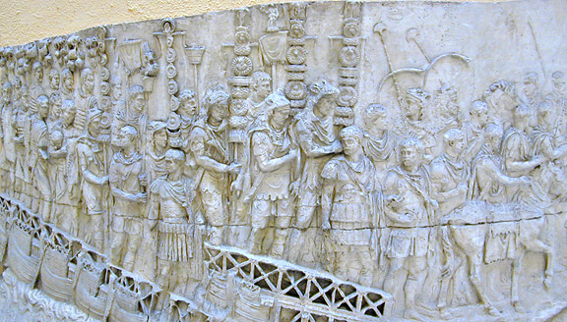
[
]
Cohort

Slide 44






Cohort:
a group of persons sharing a common characteristic

Slide 45

Women’s Health Initiative Observational Study
Notes:
https://www.whi.org/about/SitePages/Observational%20Study.aspx
“The Observational Study (OS) component of the WHI complements the Clinical Trial (CT) by assessing new risk indicators and biomarkers for disease in a large prospective cohort of 93,676 postmenopausal women.”

Slide 46
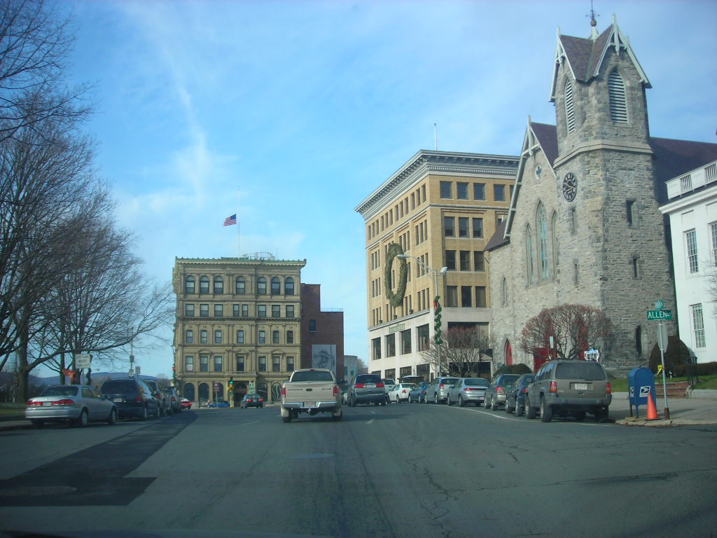
Framingham
Heart Study
Notes:
http://www.framinghamheartstudy.org/

Slide 47

Notes:
“The Agricultural Health Study (AHS) is a prospective study of licensed pesticide applicators from North Carolina and Iowa recruited in 1993-1997 at the time of license renewal.
The cohort includes 4,916 commercial applicators from Iowa and 52,395 private applicators, mostly farmers, from both states.
https://aghealth.nih.gov/

Slide 48

British Physicians Study
Cohort:
Male British Physicians
Characteristics:
Occupation, geographic location, smoking status
Outcome of interest:
Mortality

Slide 49

Cohort Study Basics
Baseline
exposure
Baseline
exposure
exposure
exposure

Slide 50
Cohort Study Basics
Baseline
exposure
Baseline
exposure
exposure
Development
of disease

Slide 51
Cohort: Male British Physicians
Exposure: Smoking
Outcome: Mortality
Smoking
death

Slide 52
Cohorts can measure various new “health outcome” events
Behavior change
disease
injury
Free of Disease
improvement

Slide 53
Often measure of health outcome in cohort study: Risk or Rate

Slide 54
Risks/Rates-start with disease FREE subjects
X
X
X

Slide 55

Retrospective Study:
Formed in the past
Prospective Study:
Starts now; goes into the future
TODAY
1950
1975
Investigator Perspective

Slide 56
Examples: Geographic area,
Workers in radiation industry,
Potential exposure to hazardous substances
e.g. Lead in Water
Retrospective Cohort Study:
Formed in the past
TODAY
1950
1975
Investigator Perspective

Slide 57
Fracking Example, Retrospective Cohort
Casey et al. 2016
Notes:
From Casey et al 2016, https://www.ncbi.nlm.nih.gov/pmc/articles/PMC4738074/
Figure 2. The Marcellus shale extent, the location of spudded and producing wells as of December 2012, the location of the two Geisinger Health System hospitals and the primary and surrounding Geisinger counties. Annotation indicates the number of neonates born to mothers residing in each county. GMC = Geisinger Medical Center. GWV = Geisinger Wyoming Valley.
Abstract
Background
Unconventional natural gas development has expanded rapidly. In Pennsylvania the number of producing wells increased from zero in 2005 to 3689 in 2013. To our knowledge, no prior publications have focused on unconventional natural gas development and birth outcomes.
Methods
We performed a retrospective cohort study using electronic health record data on 9384 mothers linked to 10946 neonates in the Geisinger Health System from January 2009-January 2013. We estimated cumulative exposure to unconventional natural gas development activity with an inverse-distance squared model that incorporated distance to the mother’s home; dates and durations of well pad development, drilling, and hydraulic fracturing; and production volume during the pregnancy. We used multilevel linear and logistic regression models to examine associations between activity index quartile and term birth weight, preterm birth, low 5 minute Apgar score and small size for gestational age, while controlling for potential confounding variables.
Results
In adjusted models, there was an association between unconventional natural gas development activity and preterm birth that increased across quartiles, with a fourth quartile odds ratio of 1.4 (95% CI: 1.0-1.9). There were no associations of activity with Apgar score, small for gestational age, or term birth weight (after adjustment for year). In a post-hoc analysis, there was an association with physician-recorded high-risk pregnancy identified from the problem list (fourth vs. first quartile, 1.3 [95% CI: 1.1-1.7]).
Conclusion
Prenatal residential exposure to unconventional natural gas development activity was associated with two pregnancy outcomes, adding to evidence that unconventional natural gas development may impact health.

Slide 58
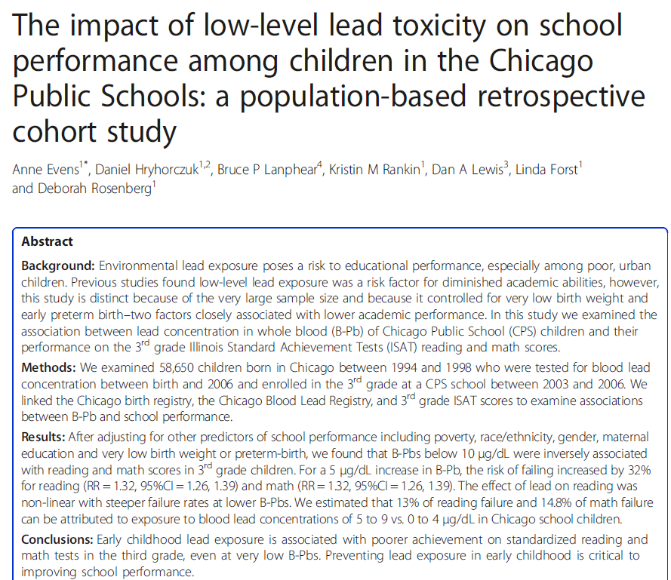
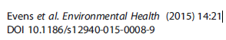
Retrospective cohort example

Slide 59
Cohort Studies
Advantages
Disadvantages
Expensive
Time-consuming
Resource-intensive
Inefficient for rare outcomes
Loss to follow-up
Directly estimate rates and risks
Good for rare exposures
Good for multiple outcomes
Provides evidence of temporality between exposure and outcome

Slide 60
Cohort Study Measures
Measures of Disease Occurrence
Risk (R)
Rate (IR)
Measures of Association
Risk Difference (RD)
Risk Ratio (RR)
Rate Ratio (IRR)
Notes:
Note that Risk Ratios (RR) are a very helpful and common measure of association. The benefit of cohort studies is that you can DIRECTLY estimate Risk Ratios, because you have all the necessary data. Other study designs, such as case control studies, can INDIRECTLY estimate Risk Ratios (RR).

Slide 61
Non-Diseased
Diseased
Exposed
a
b
(a+b)
Non-Exposed
c
d
(c+d)
Risk exp = a/(Total Exposed) = a/(a+b)
Risk unexposed = c/ (Total Unexposed) = c/(c+d)

Slide 62
Example: Doll & Hill Study
34,440 British Physicians
The follow up time was 10 years
Exposure was smoking
Outcome was ischemic heart disease
2,768 of the 28,585 smokers died of IHD
423 of the 5,855 nonsmokers died of IHD
What is risk in each group? Risk Ratio? Risk Difference?
Adapted from: Doll and Hill (1964) “Mortality and smoking: 10 year’s observations of British doctors. Brit Med J, 1: 1399-1410, 1460-1467

Slide 63
Risk by Exposure Status
R_{E} = # deaths = 2,768 IHD deaths = 0.0974 = 9.74%
at risk smokers 28,585 smokers
R_{U} = # deaths = 423 IHD deaths = 0.0722 = 7.22%
at risk 5,855 non-smokers
non-smokers

Slide 64
Risk Difference
Risk Difference = R_{E} – R_{U}
= 0.0974 - 0.0722
= 0.0252
= 2.52%
The risk of death from IHD among the British physicians who smoked in or prior to 1951 was 2.52% greater compared to the British physicians who did not smoke, over a ten year period.
Time period!

Slide 65
Risk Ratio
Risk Ratio = R_{E} / R_{U}
= 0.0974/0.0722
= 1.35
The risk of death from IHD among British physicians who smoked in or prior to 1951 was 1.35 times the risk among British physicians who did not smoke, over a ten year period.
Time period!

Slide 66
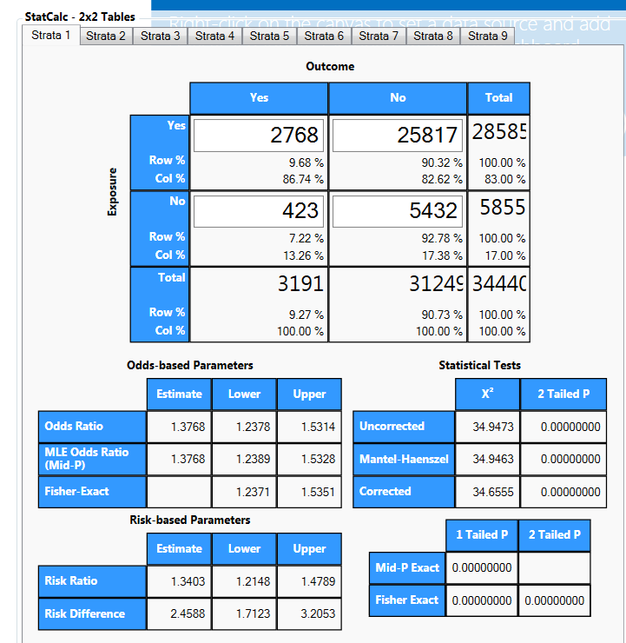
Calculating 95%CI from Two by Two Table. EpiInfo Stat Calc Tool

Slide 67
Rate Ratio
Exposed person yrs=271,558
Unexposed person yrs=49,768
Rate Ratio = Rate_{E} / Rate_{U}
= 0.010/0.0086 =1.18
The rate of death from IHD among British physicians who smoked in or prior to 1951 was 1.18 times the rate among British physicians who did not smoke, over a ten year period.

Slide 68
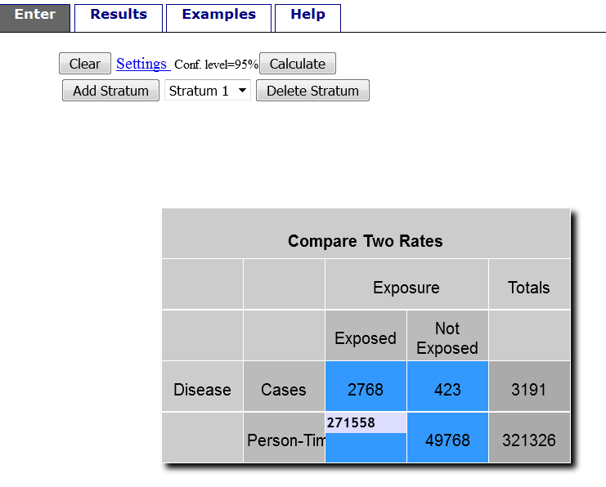
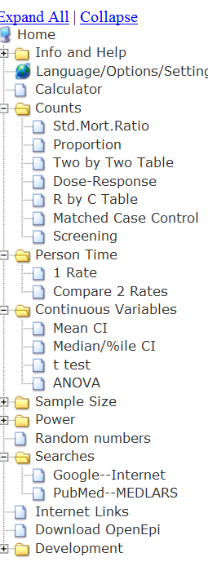
Calculating 95%CI for Rate Ratio from Open Epi

Slide 69
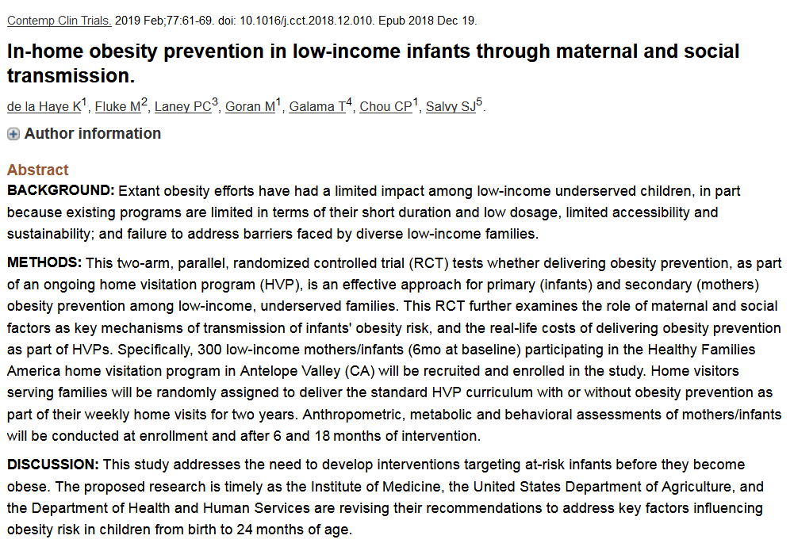
Lab related example

Slide 70
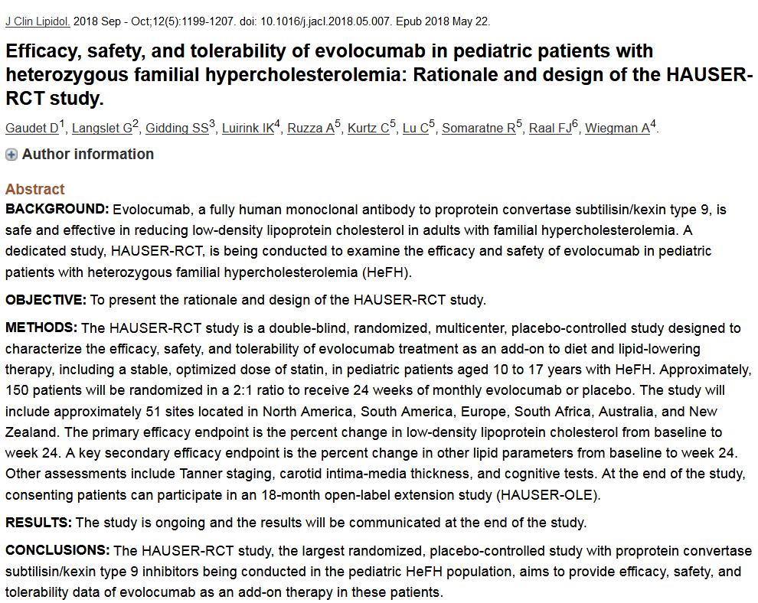
Lab related example

